Slide 1

Divide & Conquer
Charles Aunkan Gomes
Lecturer, Dept. of CSE
United International University
Courtesy: Md Shadman Aadeeb

Slide 2
Divide and Conquer
The first problem solving strategy

Slide 3
Divide and Conquer
The steps of the Divide and Conquer approach are:
Divide: Keep splitting the problem into smaller sub-problems.
Conquer: Solve the smallest sub-problems directly
Combine: Merge the solutions of the subproblems to produce the final solution for the original problem.

Slide 4
Divide and Conquer
Note that the divide and conquer problems you will be solving are mostly based on arrays
However, not all divide and conquer problems are based on arrays
Example : Strassen’s algorithm for matrix multiplication (Not in syllabus)

Slide 5
Divide and Conquer (Basic structure for array based problems)
Solve (A,start,end)
Solve (A,start,i)
Solve (A,i+1,end)
Other Function (A,start,end)
Solve (A,start,i)
Solve (A,i+1,end)
Other Function (A,start,end)

Slide 6
MIN MAX PROBLEM

Slide 7
Finding Maximum and Minimum
Index | 1 | 2 | 3 | 4 | 5 | 6 | 7 | 8 | 9
Array | 22 | 13 | -5 | -8 | 15 | 60 | 17 | 31 | 47
60,-8
MaxMin(1,9)
22,-8
MaxMin(1,5)
60,17
22,-5
MaxMin(6,9)
15,-8
Similar recursive
calls
MaxMin(1,3)
MaxMin(4,5)
22,13
-5,-5
MaxMin(1,2)
MaxMin(3,3)
-8,-8
15,15
MaxMin(4,4)
MaxMin(5,5)
22,22
13,13
MaxMin(1,1)
MaxMin(2,2)

Slide 8
Pseudocode
Find_maxmin (A, i, j)
  if i = j:
    return A[i], A[i] // base case
  else if i < j:
    mid = (i+j)/2; // divide
    mx1, min1 = Find_maxmin(A, i, mid) // conquer
    mx2, min2 = Find_maxmin(A, mid+1, j) // conquer fmax, fmin = -1, -1 // combine
    if mx1 > mx2: fmax = mx1
    else fmax = mx2
    if min1 < min2: fmin = min1
    else fmin = min2
    return fmax, fmin

Slide 9
Time Complexity
T(n) = b if n = 1
2T(n/2) + b if n > 1
By solving the recurrence, we get
T(n) is O( n )

Slide 10
MAXIMUM SUB ARRAY PROBLEM

Slide 11
MAXIMUM SUB ARRAY PROBLEM
Determine the maximum sub array from this array.
-16 | -23 | 18 | 20 | -7 | 12 | -5
0 | 1 | 2 | 3 | 4 | 5 | 6

Slide 12
Brute Force Approach
All possible contiguous subarrays
  A[1..1], A[1..2], A[1..3], ..., A[1..(n-1)], A[1..n]
  A[2..2], A[2..3], ..., A[2..(n-1)], A[2..n]
  ...
  A[(n-1)..(n-1)], A[(n-1)..n]
  A[n..n]
How many of them in total?
Algorithm: For each subarray, compute the sum.
Find the subarray that has the maximum sum.
O(n²)

Slide 13
Brute Force Approach
max = -∞
for i = 1 to n do
begin
sum = 0
for j = i to n do
begin
sum = sum + A[j]
if sum > max
then max = sum
end
end
Time complexity?
O(n²)

Slide 14
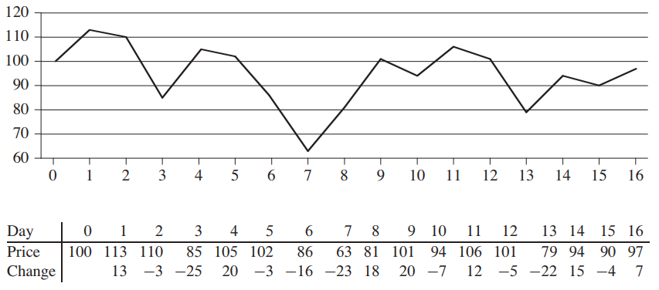
The Maximum Sub Array Problem-practical example
This is the prediction of prices of share of a company.
You want to buy the share on the day when the price is the lowest
You want to sell the share on the day when the price is the highest
Identify these two days

Slide 15
The Maximum Sub Array Problem-practical example
Buy on the 7th day and sell on the 11th day.
Total profit= 106-63=43
Also Total profit = 18+20-7+12=43

Slide 16
The Divide and Conquer Approach for Max Sub Array
Possible locations of a maximum subarray A[i..j] of A[low..high], where mid = ⎣(low + high)/2⎦
  entirely in A[low..mid] (low ≤ i ≤ j ≤ mid)
  entirely in A[mid+1..high] (mid < i ≤ j ≤ high)
  crossing the midpoint (low ≤ i ≤ mid < j ≤ high)
crossing the midpoint
low mid high
mid +1
entirely in A[low..mid]
entirely in A[mid+1..high]
Possible locations of subarrays of A[low..high]

Slide 17
The Divide and Conquer Approach for Max Sub Array
-16 | -23 | 18 | 20 | -7 | 12 | -5
0 | 1 | 2 | 3 | 4 | 5 | 6
msa(A,0,6)
38(2,3)
43(2,5)
12(5,5)
msa(A,0,3)
msa(A,4,6)
15(1,3)
7(5,6)
-16(0,0)
38(2,3)
12(5,5)
5(6,6)
msa(A,0,1)
msa(A,2,3)
msa(A,4,5)
msa(A,6,6)
-39(0,1)
38(2,3)
-23(1,1)
18(2,2)
20(3,3)
-7(4,4)
12(5,5)
-16(0,0)
msa(A,0,0)
msa(A,1,1)
msa(A,2,2)
msa(A,3,3)
msa(A,4,4)
msa(A,5,5)

Slide 18
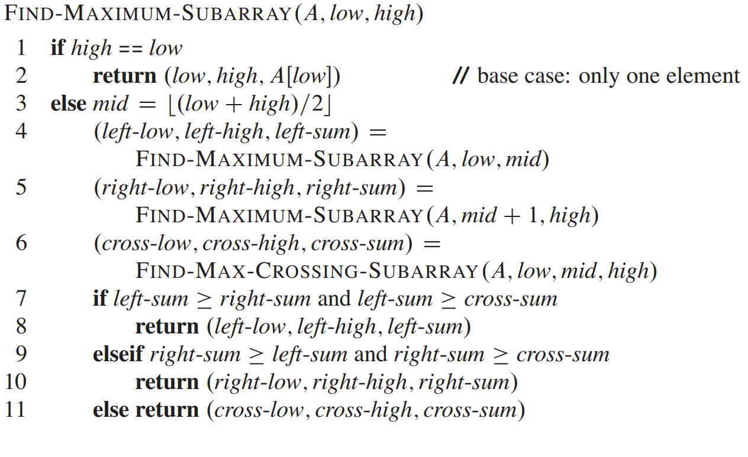
Pseudocode

Slide 19
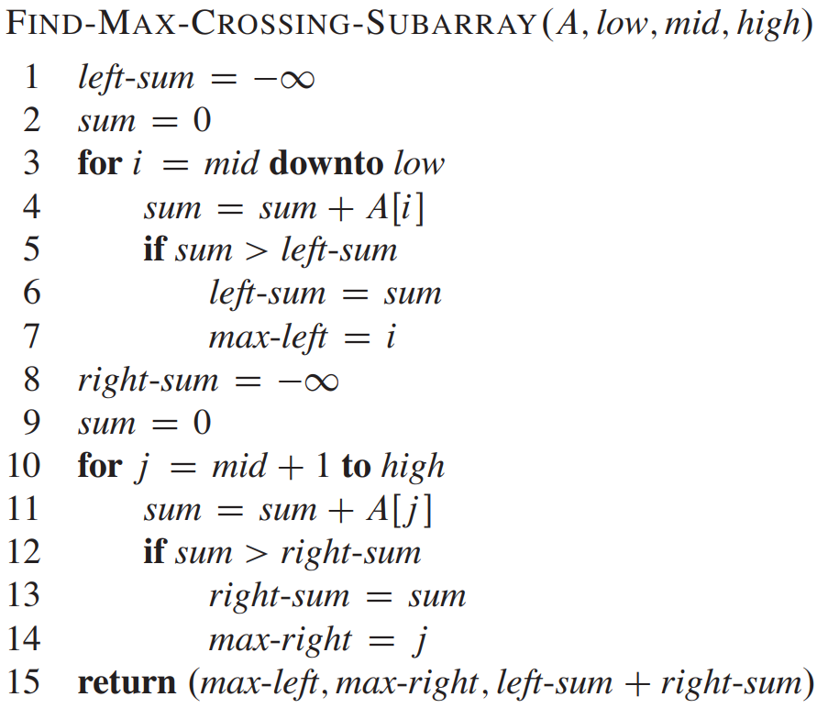
Pseudocode
-16 | -23 | 18 | 20 | -7 | 12 | -5
0 | 1 | 2 | 3 | 4 | 5 | 6

Slide 20
Pseudocode
leftSum=-inf
-16 | -23 | 18 | 20 | -7 | 12 | -5
0 | 1 | 2 | 3 | 4 | 5 | 6

Slide 21
Pseudocode
leftSum=-inf
Sum =0
-16 | -23 | 18 | 20 | -7 | 12 | -5
0 | 1 | 2 | 3 | 4 | 5 | 6

Slide 22
Pseudocode
leftSum=-inf
Sum =0
-16 | -23 | 18 | 20 | -7 | 12 | -5
0 | 1 | 2 | 3 | 4 | 5 | 6

Slide 23
Pseudocode
leftSum=-inf
Sum =0
-16 | -23 | 18 | 20 | -7 | 12 | -5
0 | 1 | 2 | 3 | 4 | 5 | 6
i

Slide 24
Pseudocode
leftSum=-inf
Sum =20
-16 | -23 | 18 | 20 | -7 | 12 | -5
0 | 1 | 2 | 3 | 4 | 5 | 6
i

Slide 25
Pseudocode
leftSum=-inf
Sum =20
-16 | -23 | 18 | 20 | -7 | 12 | -5
0 | 1 | 2 | 3 | 4 | 5 | 6
i

Slide 26
Pseudocode
leftSum=20
Sum =20
-16 | -23 | 18 | 20 | -7 | 12 | -5
0 | 1 | 2 | 3 | 4 | 5 | 6
i

Slide 27
Pseudocode
leftSum=20
Sum =20
maxLeft=4
-16 | -23 | 18 | 20 | -7 | 12 | -5
0 | 1 | 2 | 3 | 4 | 5 | 6
i

Slide 28
Pseudocode
leftSum=20
Sum =20
maxLeft=4
-16 | -23 | 18 | 20 | -7 | 12 | -5
0 | 1 | 2 | 3 | 4 | 5 | 6
i

Slide 29
Pseudocode
leftSum=20
Sum =38
maxLeft=4
-16 | -23 | 18 | 20 | -7 | 12 | -5
0 | 1 | 2 | 3 | 4 | 5 | 6
i

Slide 30
Pseudocode
leftSum=20
Sum =38
maxLeft=4
-16 | -23 | 18 | 20 | -7 | 12 | -5
0 | 1 | 2 | 3 | 4 | 5 | 6
i

Slide 31
Pseudocode
leftSum=38
Sum =38
maxLeft=4
-16 | -23 | 18 | 20 | -7 | 12 | -5
0 | 1 | 2 | 3 | 4 | 5 | 6
i

Slide 32
Pseudocode
leftSum=38
Sum =38
maxLeft=3
-16 | -23 | 18 | 20 | -7 | 12 | -5
0 | 1 | 2 | 3 | 4 | 5 | 6
i

Slide 33
Pseudocode
leftSum=38
Sum =38
maxLeft=3
-16 | -23 | 18 | 20 | -7 | 12 | -5
0 | 1 | 2 | 3 | 4 | 5 | 6
i

Slide 34
Pseudocode
leftSum=38
Sum =15
maxLeft=3
-16 | -23 | 18 | 20 | -7 | 12 | -5
0 | 1 | 2 | 3 | 4 | 5 | 6
i

Slide 35
Pseudocode
leftSum=38
Sum =15
maxLeft=3
-16 | -23 | 18 | 20 | -7 | 12 | -5
0 | 1 | 2 | 3 | 4 | 5 | 6
i

Slide 36
Pseudocode
leftSum=38
Sum =15
maxLeft=3
-16 | -23 | 18 | 20 | -7 | 12 | -5
0 | 1 | 2 | 3 | 4 | 5 | 6
i

Slide 37
Pseudocode
leftSum=38
Sum =9
maxLeft=3
-16 | -23 | 18 | 20 | -7 | 12 | -5
0 | 1 | 2 | 3 | 4 | 5 | 6
i

Slide 38
Pseudocode
leftSum=38
Sum =9
maxLeft=3
-16 | -23 | 18 | 20 | -7 | 12 | -5
0 | 1 | 2 | 3 | 4 | 5 | 6
i

Slide 39
Pseudocode
leftSum=38
Sum =9
maxLeft=3
-16 | -23 | 18 | 20 | -7 | 12 | -5
0 | 1 | 2 | 3 | 4 | 5 | 6
i

Slide 40
Pseudocode
leftSum=38
Sum =9
maxLeft=3
-16 | -23 | 18 | 20 | -7 | 12 | -5
0 | 1 | 2 | 3 | 4 | 5 | 6
i
Similarly the right sum is determined

Slide 41
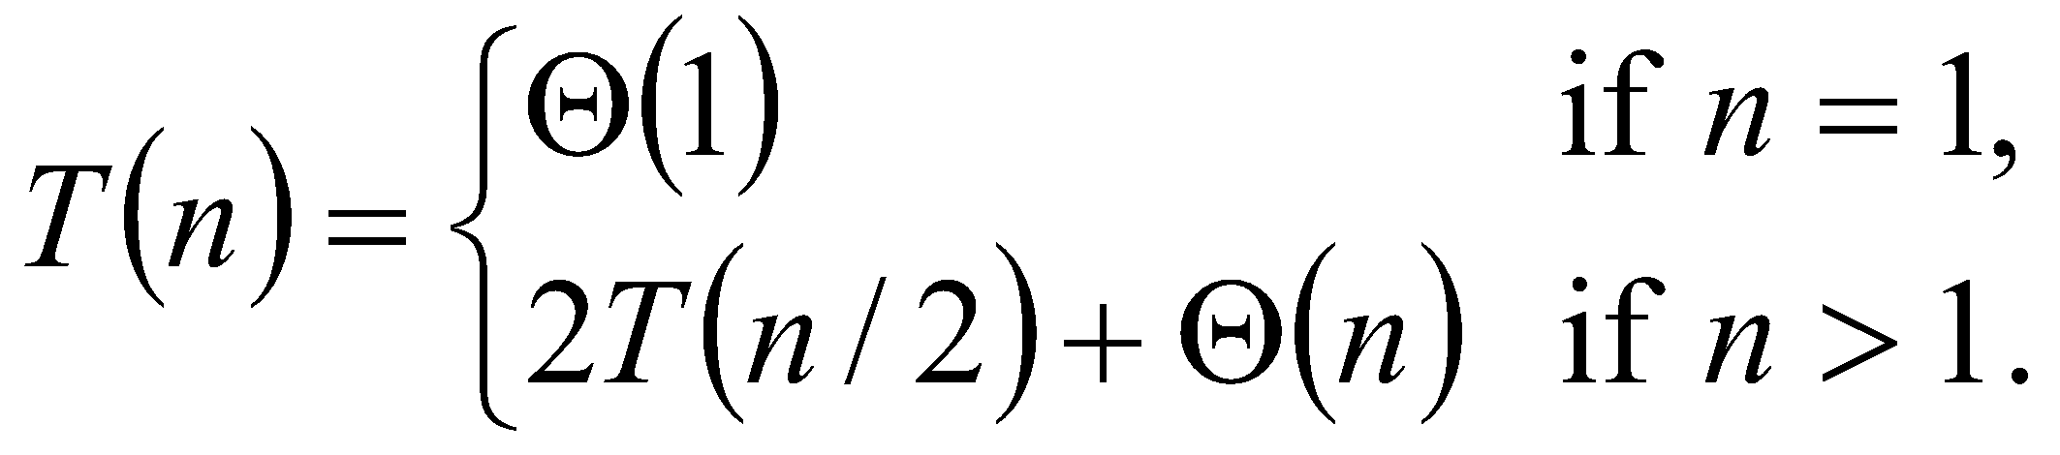
Time Complexity
FIND-MAX-CROSSING-SUBARRAY : Θ(n),
FIND-MAXIMUM-SUBARRAY
T(n) = 2T(n/2) + Θ(n)
= Θ(nlogn) (similar to merge-sort)

Slide 42
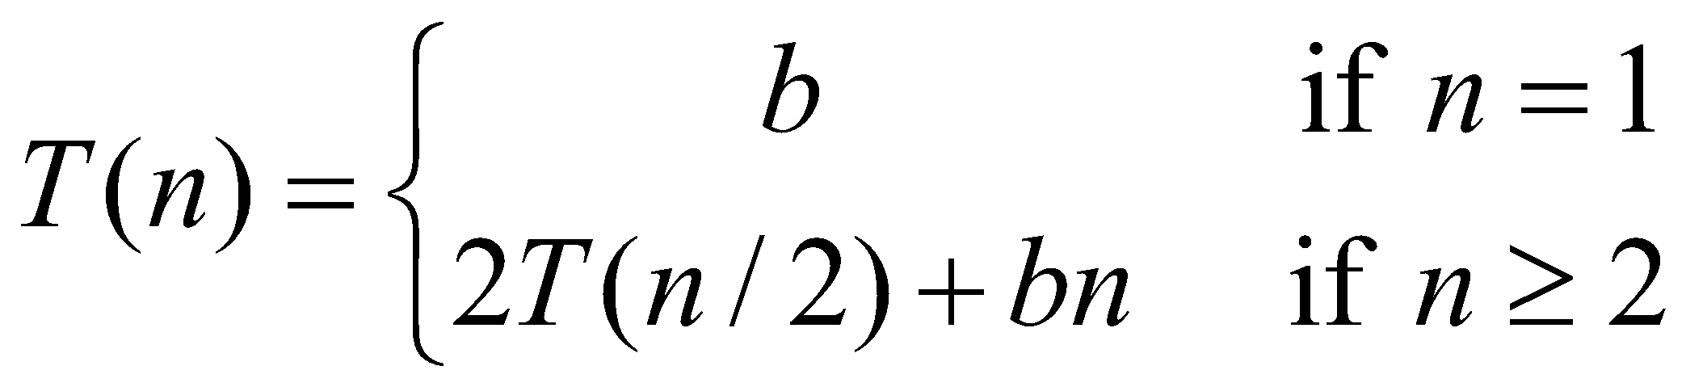
Time Complexity (Recursive Tree)
Draw the recursion tree for the recurrence relation and look for a pattern:
depth | T’s | size
0 | 1 | n
1 | 2 | n/2
… | … | …
i | 2^{i} | n/2^{i}
Time for max crossing sub array
bn
bn:(bn/2+bn/2)
bn:(bn/4+bn/4+bn/4+bn/4)
…
Total time = i * bn
i = log n.
T(n) = bnlog n +bn

Slide 43
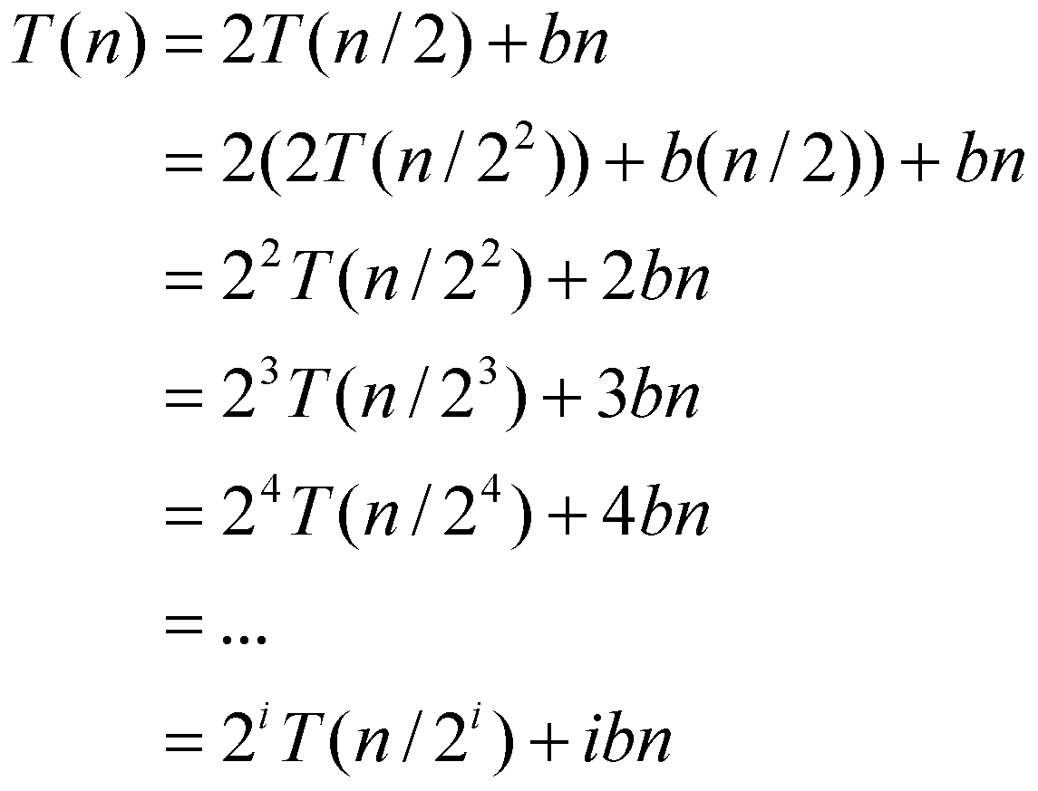
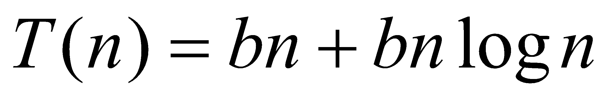
Time Complexity (Iterative Approach)
Note that base, T(n) =b, case occurs when 2^{i} = n.
That is, i = log n.
So,
Thus, T(n) is O(n log n).

Slide 44
Similar Problems
You are given an array P [1..100], where an index is marked as 1 if it is a prime number or 0 if it is not a prime number (see the array below for reference). Determine the total number of prime numbers in a given array using a divide and conquer algorithm. Draw the recursive tree and write the pseudocode.
1 | 2 | 3 | 4 | 5 | 6 | . | . | 99 | 100
0 | 1 | 1 | 0 | 1 | 0 |  |  | 0 | 0

Slide 45
Conclusion: Divide-and-Conquer
This Divide and conquer algorithm is clearly substantially faster than any of the brute-force methods. It required some cleverness, and the programming is a little more complicated – but the payoff is large.
Divide and conquer is just one of several powerful techniques for algorithm design
Divide-and-conquer algorithms can be analyzed using recurrences
Can lead to more efficient algorithms

Slide 46


